Slide 1
NM ID: au211521104113 Reg.No. 211521104113
NAME: PRAVEEN M
Final Project
1

Slide 2
PROJECT TITLE
OBJECT DISTANCE ESTIMATION USING CONVOLUTIONAL NEURAL NETWORK
2

Slide 3


AGENDA
Problem Statement
Proposed Solution
Introduction to Object Distance Estimation
Overview of Convolutional Neural Networks (CNNs)
Dataset Collection and Annotation
Evaluation Metrics and Validation
System Approach
Conclusion and Future Work
3

Slide 4

PROBLEM STATEMENT
Accurate object distance estimation is essential for robotics, autonomous vehicles, and augmented reality, enabling informed decisions and safe operations. Challenges include limited annotated datasets, environmental variability, occlusions, and the need for real-time performance. Environmental factors like lighting, weather, and clutter complicate estimation accuracy. Occlusions obstruct views, impacting algorithm precision. Real- time demands necessitate lightweight, efficient solutions. Overcoming these challenges is vital for advancing object distance estimation, enhancing safety, and realizing its potential in various applications.
4

Slide 5
PROPOSED SOLUTION:
To tackle challenges in object distance estimation, the proposed solution involves dataset augmentation, adaptable models for environmental variability, occlusion-handling algorithms, real- time optimization, robust feature extraction with CNN architectures, and continuous learning mechanisms. Thorough validation ensures effectiveness across applications, leading to more accurate, robust, and efficient distance estimation systems for robotics, autonomous vehicles, and augmented reality. The integration of advanced sensor technologies, such as LiDAR and depth cameras, can enhance the accuracy and reliability of distance estimation in varying environmental conditions.

Slide 6
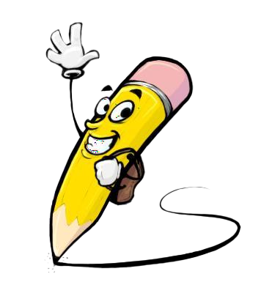
PROJECT OVERVIEW
INTRODUCTION:
Object Distance Estimation is a crucial component in various real- world applications, where the precise measurement of distances between objects and sensors is essential for informed decision- making and operational safety. From robotics to autonomous vehicles and augmented reality, accurate distance estimation enables these systems to navigate their environments effectively, avoid obstacles, and interact with objects in a controlled manner.
6

Slide 7
OVERVIEW OF CONVOLUTIONAL NEURAL
NETWORK (CNNs):
Convolutional Neural Networks (CNNs) are pivotal in modern visual data analysis, mimicking human visual perception to recognize patterns within images. Their hierarchical architecture and ability to learn spatial hierarchies have revolutionized computer vision, image classification, and object detection. In object distance estimation, CNNs excel at extracting relevant features and learning complex relationships between these features and object distances. Leveraging large datasets and computational power, CNNs can effectively model the mapping between input features and distances, yielding accurate and robust estimations.

Slide 8
DATASET COLLECTION AND ANNOTATION:
Dataset collection and annotation for object distance estimation using CNNs involves defining object classes, selecting appropriate sensors, setting up realistic environments, annotating data with ground truth labels, and augmenting the dataset for robustness. Splitting the dataset into training, validation, and test sets, along with documentation and ethical considerations, ensures reliability. Sharing the annotated dataset encourages collaboration and benchmarkingwithin the research community.
Evaluation Metrics and Validation:
Evaluation metrics such as Mean Absolute Error (MAE), Root Mean Square Error (RMSE), and Coefficient of Determination (R-squared) provide insights into the accuracy and fit of CNN-based object distance estimation models. Additionally, Precision-Recall (PR) and Receiver Operating Characteristic (ROC) curves offer a deeper understanding of the model's performance across different distance estimation thresholds. Cross-validation, holdout validation, and test set evaluation ensure robustness and generalization capabilities of the models across diverse real-world scenarios and datasets.

Slide 9
SYSTEM APPROACH
HARDWARE REQUIREMENT:
CPU: A modern multi-core CPU is required for running training and inference tasks.
GPU: A dedicated GPU is recommended for faster training and inference speeds, especially when working with larger datasets and complex CNN architectures.
Storage: Adequate storage space is required for storing datasets, trained models, and intermediate results generated during training and inference
tasks.
Memory (RAM): Sufficient system memory (RAM) is necessary for loading and processing large datasets during training and inference.

Slide 10
SYSTEM APPROACH-CONT.
SOFTWARE REQUIREMENT:
Python: YOLO implementations are commonly developed in Python due to its simplicity and availability of machine learning libraries.
Deep Learning Frameworks: Install deep learning frameworks such as TensorFlow or PyTorch, as YOLO implementations are often built using these frameworks for model training and inference.
YOLO Implementation: Obtain or implement YOLO-based algorithms
for object detection and localization. Popular implementations include Darknet (for YOLOv1-v3) or YOLOv4/v5 repositories available on GitHub.
Data Preprocessing Tools: Utilize tools like OpenCV for image preprocessing, augmentation, and manipulation tasks required for training
and testing datasets.

Slide 11
CONCLUSION AND FUTURE WORK
In conclusion, object distance estimation utilizing CNNs shows great potential across diverse applications like robotics, autonomous vehicles, and augmented reality. Despite challenges such as data scarcity, environmental variability, and real-time processing demands, solutions like dataset augmentation and real-time optimization have shown promise in enhancing accuracy. For future endeavors, advancements in environmental modeling, multi-modal fusion, and occlusion handling are crucial. Additionally, exploring real-time optimization, domain adaptation, and uncertainty estimation techniques can further improve performance. Embracing edge computing and deploying CNN-based models can lead to more efficient and intelligent systems, driving innovation in object distance estimation for safer and more effective real-world applications.

Slide 12
WHO ARE THE END USERS?
Autonomous Vehicles: End users include automobile manufacturers, transportation companies, and eventually consumers who benefit from improved safety and navigation features enabled by accurate object distance estimation.
Robotics: End users encompass robotics engineers, manufacturers, and researchers utilizing
distance estimation for robot navigation, object manipulation, and interaction in various
environments.
Augmented Reality (AR) and Virtual Reality (VR): End users consist of developers, content
creators, and consumers who use distance estimation to enhance immersive experiences, such as virtual object placement and interaction with real-world environments.
Surveillance Systems: End users involve security firms, law enforcement agencies, and businesses employing distance estimation to monitor and analyze object movements and behaviors in surveillance footage for security purposes.
Industrial Automation: End users include manufacturing companies and automation engineers who utilize distance estimation for quality control, object tracking, and process optimization in
industrial settings.
Healthcare: End users encompass medical professionals and researchers who leverage distance
estimation for applications like surgical navigation, medical imaging analysis, and patient monitoring.
Smart Cities: End users consist of city planners, infrastructure developers, and citizens benefiting
from improved urban planning, traffic management, and public safety enabled by object distance estimation in smart city initiative.
1
2

Slide 13

YOUR SOLUTION AND ITS VALUE PROPOSITION
The object distance estimation solution utilizes YOLO (You Only Look Once) architecture to precisely measure distances from images or sensor data. Beginning with data collection and preprocessing, it ensures robust training. By customizing YOLO, such as YOLOv3 or YOLOv4, it optimizes for accurate distance estimation. Training involves dataset splitting, augmentation, and assessing metrics like MAE, MSE, or RMSE. Deployment ensures seamless integration across platforms, adapting to diverse environments. Its value proposition includes high accuracy, efficient processing, adaptability, task automation, and scalability to evolving needs.
1
3

Slide 14

THE WOW IN YOUR SOLUTION
Real-time Performance: The YOLO architecture is renowned for its efficiency in real- time object detection, enabling rapid processing of video streams or camera feeds. By incorporating CNNs for distance estimation directly into the YOLO framework, the solution maintains this real-time capability while simultaneously providing accurate distance estimates for detected objects.
Single-stage Detection and Distance Estimation: Unlike traditional approaches that require separate models for object detection and distance estimation, the integrated
YOLO CNN model performs both tasks in a single stage. This streamlined approach reduces computational complexity and inference time, resulting in faster and more
efficient processing.
End-to-End Learning: The YOLO CNN model learns to detect objects and estimate their distances simultaneously through end-to-end training. This holistic learning
approach allows the model to capture complex relationships between object appearances and their corresponding distances, leading to improved accuracy and
generalization.
Robustness to Occlusions and Clutter: By jointly optimizing object detection and
distance estimation, the YOLO CNN model inherently learns to handle occlusions and
clutter in the scene. This robustness enables accurate distance estimation even in challenging scenarios where objects are partially obscured or surrounded by clutter.
Scalability and Adaptability: The modular nature of the YOLO CNN architecture allows for easy scalability and adaptation to different applications and environments. Whether deployed in robotics, autonomous vehicles, or augmented reality systems, the
solution can be customized and fine-tuned to meet specific requirements.
3/21/2024 Annual Review
14

Slide 15
MODELLING
Data Collection and Preprocessing:
Gather a dataset containing images with annotated bounding boxes around objects of interest and labeled distances to those objects.
Preprocess the images and annotations to ensure uniformity and compatibility with YOLO architecture.
Model Architecture Selection:
Choose a YOLO variant suitable for object detection tasks, such as YOLOv3 or YOLOv4.
Modify the YOLO architecture to output not only bounding boxes but also include a CNN branch for distance estimation.
Training:
Split the dataset into training, validation, and testing sets.
Employ techniques like transfer learning if pre-trained YOLO weights available to expedite training.
are
15

Slide 16
MODELLING-CONT.
Evaluation:
Evaluate the trained model on the validation set to fine-tune hyperparameters and ensure it generalizes well to unseen data.
Assess the model's performance using metrics like Mean Absolute Error (MAE) for distance estimation and Mean Average Precision (mAP) for object detection.
Deployment and Integration:
Deploy the trained model to the desired platform, ensuring compatibility with YOLO's inference process.
Integrate the model with existing systems or applications where object detection and distance estimation are required, ensuring seamless interaction with sensors or cameras.

Slide 17
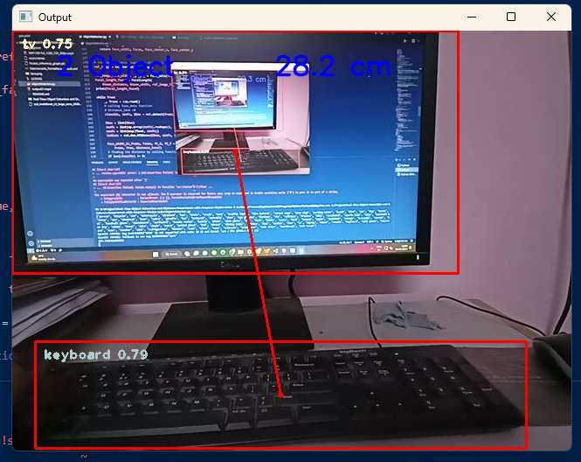
RESULTS
Code Link: https://github.com/Praveen-M004/TNSDC_Generative-AI.git
17

